Slide 1

Time Series Analysis
By
Jiten Sahoo

Slide 2

What is Time Series Data?
Time series refers to a chain of data points observed and recorded in a time order over a specific period. It represents the output obtained from monitoring and tracking specific events or processes.
Time series contains observation in the numerical form represented in chronological order.

Slide 3
It can be categorized into different types; one is the categorization into non-stationary and stationary time series. If stationary, it has stochastic properties like variance unvarying with time. Whereas for non-stationary, its properties vary with time, and it can be a trend, random occurrences, seasons, cycles, etc. It is easy and effective to model when it is stationary by applying statistical modeling methods.

Slide 4
Components of Time Series Analysis
Trend
Seasonal Variations
Cyclical Variations
Random or Irregular Movements

Slide 5
Trend
Trend shows a common tendency of data. It may move upward or increase or go downward or decrease over a certain, long period of time. The trend is a stable and long-term general tendency of movement of the data. To be a trend, it is not mandatory for the data to move in the same direction. The direction or movement may change over the long-term period but the overall tendency should remain the same in a trend.
Some of the examples of trends include – the number of schools, agricultural production, increase in population, etc. It is notable that the trend may move upward, go downward or remain stable over different sections of time.
A Trend can be either linear or non-linear.

Slide 6
Seasonal Variations
These are the rhythmic forces which operate in a regular and periodic manner over a span of less than a year. They have the same or almost the same pattern during a period of 12 months. This variation will be present in a time series if the data are recorded hourly, daily, weekly, quarterly, or monthly.
These variations come into play either because of the natural forces or man-made conventions. The various seasons or climatic conditions play an important role in seasonal variations. Such as production of crops depends on seasons, the sale of umbrella and raincoats in the rainy season, and the sale of electric fans and A.C. shoots up in summer seasons.

Slide 7
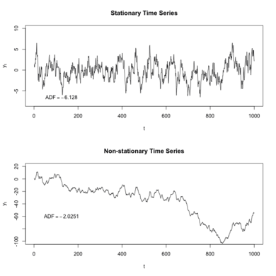
Stationarity
stationarity means that the statistical properties of a process generating a time series do not change over time .

Slide 8
Statistical Models of time series forecasting AR MA
AR:
It is nothing but Auto regressive Model.
An autoregression model makes an assumption that the observations at previous time steps are useful to predict the value at the next time step.
This relationship between variables is called correlation.
We can calculate AR by PACF.

Slide 9
ACF (Auto Correlation Function)
Auto Correlation function takes into consideration of all the past observations irrespective of its effect on the future or present time period. It calculates the correlation between the t and (t-k) time period. It includes all the lags or intervals between t and (t-k) time periods. Correlation is always calculated using the Pearson Correlation formula.

Slide 10
PACF(Partial Auto Correlation Function)
The PACF determines the partial correlation between time period t and t-k. It doesn’t take into consideration all the time lags between t and t-k. For e.g. let's assume that today's stock price may be dependent on 3 days prior stock price but it might not take into consideration yesterday's stock price closure. Hence we consider only the time lags having a direct impact on future time period by neglecting the insignificant time lags in between the two-time slots t and t-k.

Slide 11
MA
MA stands for Moving Average
A moving average is a technical indicator that investors and traders use to determine the trend direction of securities.
It is calculated by adding up all the data points during a specific period and dividing the sum by the number of time periods.
Moving averages help technical traders to generate trading signals.

Slide 12
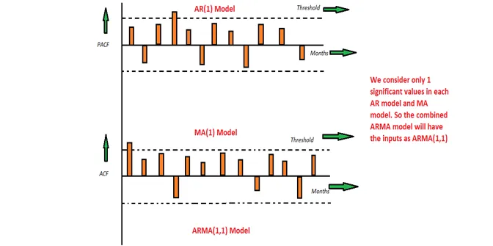
We use PACF plot for calculating AR and ACF term to calculate MA.
https://towardsdatascience.com/time-series-models-d9266f8ac7b0

Slide 13
ARMA use p and q two terms ( which are PACF and ACF) for building time series model.
from statsmodels.graphics.tsaplots import plot_pacf from statsmodels.graphics.tsaplots import plot_acf from statsmodels.tsa.arima_process import ArmaProcess

Slide 14
ARIMA Model
ARIMA stands for AutoRegressive Integrated Moving Average.
This model is the combination of autoregression, a moving average model and differencing. In this context, integration is the opposite of differencing.
Differencing is useful to remove the trend in a time series and make it stationary.
It simply involves subtracting a point a t-1 from time t. Realize that you will, therefore, lose the first data point in a time series if you apply differencing once.

Slide 15
Mathematically, the ARIMA(p,d,q) now requires three parameters:
p: the order of the autoregressive process
d: the degree of differencing (number of times it was differenced)
q: the order of the moving average process

Slide 16
How to check stationarity
Using Hypothesis testing ( Adfuller Test)
ad_fuller_result = adfuller(data['data'])
Then find the p-value of that . If p-value is greater than 0.05, then the data is non stationary, if it is less than 0.05, then data is stationary.
Note : null hypothesis – data is not stationary
Alternative hypothesis – data is stationary

Slide 17
Null Hypothesis (H0): If failed to be rejected, it suggests the time series has a unit root, meaning it is non-stationary. It has some time dependent structure.
Alternate Hypothesis (H1): The null hypothesis is rejected; it suggests the time series does not have a unit root, meaning it is stationary. It does not have time-dependent structure.

Slide 18
Convert to stationary
We can find the difference between the data and one shift and perform hypothesis testing on that.
Once we find that we can get the value of p,d,q

Slide 19
Problems with ARIMA
It is unable to handle seasonal data as it has only trends .
SO for that we use SARIMA

Slide 20
SARIMA
Seasonal ARIMA
It is used to handle seasonal data.
A seasonal autoregressive integrated moving average (SARIMA) model is one step different from an ARIMA model based on the concept of seasonal trends. In many time series data, frequent seasonal effects come into play.
Take for example the average temperature measured in a location with four seasons. There will be a seasonal effect on a yearly basis, and the temperature in this particular season will definitely have a strong correlation with the temperature measured last year in the same season.
It has some extra parameter called seasonal parameter (P,D,Q,M)

Slide 21
SARIMAX
It adds the flexibility of exogenous variable (regressor).
It is basically provides us flexibility to use multiple variables in our model.
SARIMAX(Seasonal Auto-Regressive Integrated Moving Average with eXogenous factors) is an updated version of the ARIMA model. ARIMA includes an autoregressive integrated moving average, while SARIMAX includes seasonal effects and eXogenous factors with the autoregressive and moving average component in the model. Therefore, we can say SARIMAX is a seasonal equivalent model like SARIMA and Auto ARIMA.

Slide 22
from statsmodels.api.tsa.statespace import SARIMAX
Model = SARIMAX(data['Sales'],order=(1, 1, 1),seasonal_order=(1,1,1,12))
results=model.fit()

Slide 23
Auto Arima
We can use auto arima module for implementing the arima model.
It has the advantage of getting P,D,Q value automatically. We don’t have to find those values externally.
The auto-ARIMA process seeks to identify the most optimal parameters for an ARIMA model.
e.g
from pmdarima import auto_arima

Slide 24
Holts winter
The Holt-Winters method uses exponential smoothing to encode lots of values from the past and use them to predict “typical” values for the present and future. Exponential smoothing refers to the use of an exponentially weighted moving average (EWMA) to “smooth” a time series.
from statsmodels.tsa.holtwinters import ExponentialSmoothing

Slide 25
FB prophet
FbProphet is a powerful time series analysis package released by Core Data Science Team at Facebook. It is simple and easy to go package for performing time series analytics and forecasting at scale.
Prophet is a procedure for forecasting time series data based on an additive model where non-linear trends are fit with yearly, weekly, and daily seasonality, plus holiday effects. It works best with time series that have strong seasonal effects and several seasons of historical data. Prophet is robust to missing data and shifts in the trend, and typically handles outliers well.

